Slide 1
Building a Swing GUI
Using Eclipse’s WindowBuilder

Slide 2
Install WindowBuilder
Open Eclipse
Click Help…
Select Install new software…
Access the following website: https://www.eclipse.org/windowbuilder/download.php
Copy the installation URL that matches your eclipse version to the “work with:” field.
Install WindowsBuilder
Restart Eclipse

Slide 3
Import the Project from LMS
For those of you who are interested in how to create your own without importing the LMS Project:
Create a new Java Project
Then Right Click on the src folder and do:
New > Other > WindowBuilder > Swing Designer > Application Window

Slide 4
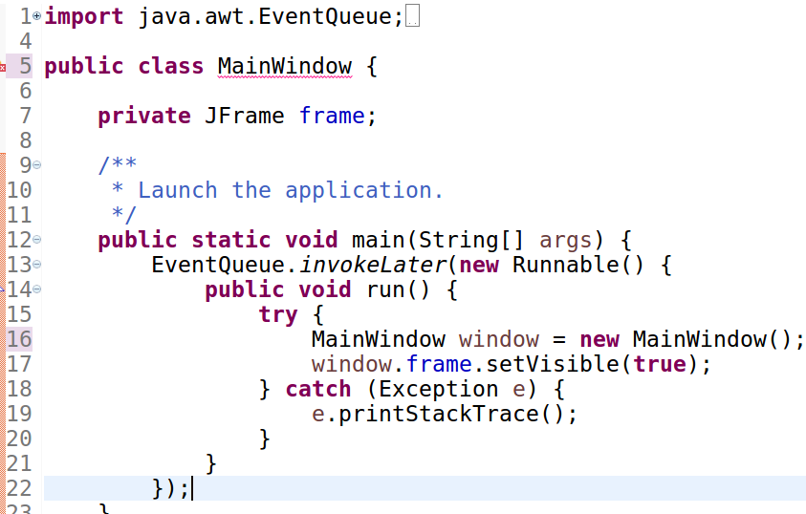

Slide 5
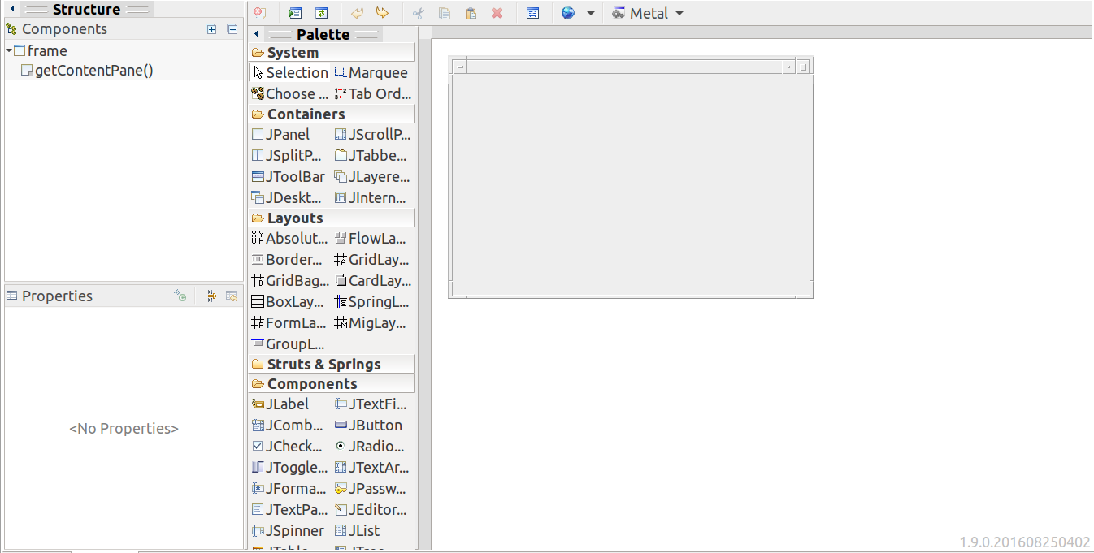

Slide 6
Layouts - A crash course
Absolute Layout : Does not scale when resized
Grid Layout: Items are rendered on a grid and will stack or unstack depending on the size of the window
GridBagLayout: https://docs.oracle.com/javase/tutorial/uiswing/layout/gridbag.html

Slide 7
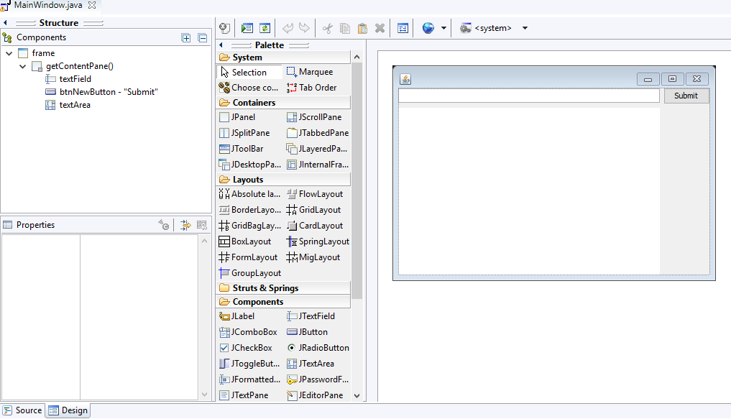
Add things to the GUI as desired

Slide 8
Event Handlers
Right click a component (i.e. a button) and select
Event Handler > action > actionPerformed
See line 81 - 85 of MainWindow.java

